Slide 1

REMOTELY ACTIVATED CONTROL AND DEMAND RESPONSE OF AGGREGATED ELECTRIC VEHICLES
Michael McDonald (s1425486)
Electrical and Mechanical Engineering BEng (hons) 1 February 2017

Slide 2
“This project will focus on the technical and economical feasibility of providing grid services through demand response on vehicles that are connected to a uni-directional charge point with no smart capabilities”

Slide 3
REVIEW OF FINDINGS DEMAND RESPONSE CO-ORDINATION
10 sec
30 sec
1 min
10 min
30 min
1 hour
2 hour
4 hour
2 sec
Firm Frequency Response (FFR)
and
Frequency Control by Demand Management (FCDM)
Short Term Operating Reserve (STOR)
Large Generators
[Curtis M, 2015]
Notes:
Referenced: Overview of the UK Demand Response (Mitchell Curtis 2015)

Slide 4
REVIEW OF FINDINGS FREQUENCY RESPONSE SERVICES
Technology | Minimum size* | Notice Period | Duration | Regularity** | Value*** | Contract
Static Firm Frequency Response (FFR) | 10MW | 30 sec | Max 30 min Typically 5 min | 10–30 | ££ | Monthly electronic tender
Dynamic FFR | 10MW | 2 sec | Max 30 min Typically 3-4 min | Daily | £££ | Monthly electronic tender
FFR Bridging | <10MW | 30 sec | 30 min | 10–30 | ££ | Bilateral contract of 12–24 months to transition in to the FFR market (either Static or Dynamic).
Frequency Control by Demand Management (FCDM) | 3 MW | 2 sec | 30 min | 10 | ££ | Bilateral contracts for 1–2 yrs. Week ahead notification of daily load able to shed
Enhanced Response (EFR) | 1-5MW | 1 sec dynamic | Max 15 min Typically 3–4 min |  | £££ | New product – trial tender
[National Grid, 2017]
Notes:
* to contract directly with National Grid (smaller loads via demand side providers)
** Average number of times called on per year, based on recent data. Source: National Grid
*** Relative value to participant
£ the greater the number of ‘£’ signs indicates a greater value to the demand side participant
Referenced : Demand Side Flexibility Annual Report 2016 (National Grid 2017)

Slide 5
REVIEW OF FINDINGS RESERVE SERVICES
Technology | Minimum size | Notice Period | Duration | Regularity | Value | Contract
Short Term Operating Reserve (STOR) | 3MW | 20 min | 2–4 hrs Typically | Able to deliver 3x per week | £ | 3 tenders p.a. ‘Committed’ or ‘Flexible’ service
STOR Runway | <3MW | 20 min | 2–4 hrs Typically | Able to deliver 3x per week | £ | Bilateral contract
Fast Reserve | 50MW | 2 min, reaching 50 MW in 4 min | 15 min |  | £ | Monthly tender
Demand Turn Up | 1MW | 10 min, sometimes requested day-ahead | Min 30 min |  | £ | New product – trial tender
[National Grid, 2017]
Notes:
£ the greater the number of ‘£’ signs indicates a greater value to the demand side participant
Referenced : Demand Side Flexibility Annual Report 2016 (National Grid 2017)

Slide 6
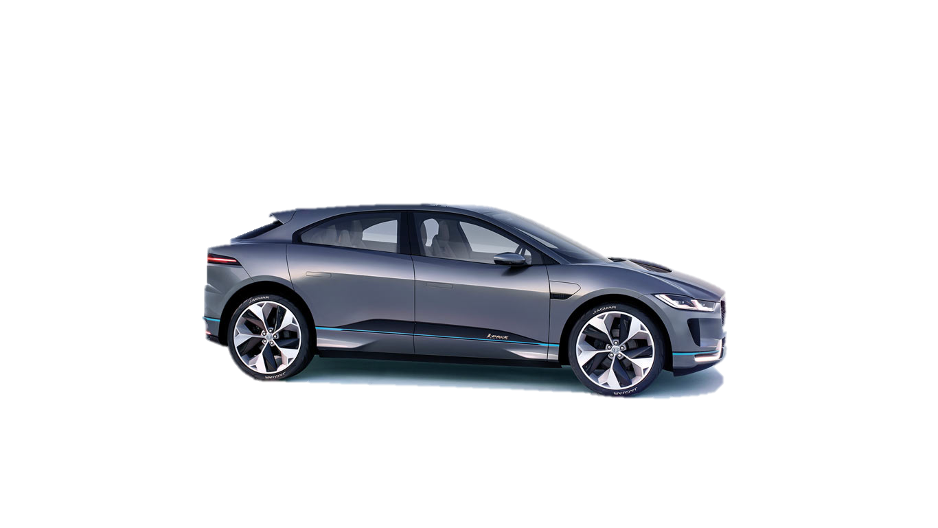
VEHICLE DEFINITIONS BEV and PHEV
Vehicle | Class | Battery Capacity | Max Charge Rate | Time to charge at home | Range on battery
Jaguar I-Pace | Battery Electric Vehicle (BEV) | ~100 kWh | 150kW | 15 Hours (7kW) | 310 miles
Audi Q7 E-Tron | Plug in Hybrid Electric Vehicle (PHEV) | 17.3 kWh | 7kW | 2.5 Hours (7kW) | 34 miles
Audi Q7 E-Tron
Jaguar I-Pace
[Audi, 2018]
[JLR, 2018]
Notes:
The target vehicles chosen are the Jaguar I-Pace battery electric vehicles and the Audi Q7 e-tron plug in hybrid vehicle. These were chosen as the high range electric vehicles will have the highest demand response capabilities per device with the plug in hybrids offering the least disturbance to drivers and the two being in a comparable vehicle bracket
Image credit: http://ksassets.timeincuk.net/wp/uploads/sites/54/2017/03/jaguar-ipace-4-1.jpg/
https://www.audi.co.uk/audi-innovation/e-tron.html
Information sources:
I-Pace: Abhishek Sampat, JLR
e-tron: https://www.audi.co.uk/audi-innovation/e-tron.html

Slide 7
SYSTEM LOGIC CHARGE CONTROL WITHOUT DSR
EV Plugged in
0
1
CHARGING
SOC < 100%
NOT CHARGING
1
0

Slide 8
SYSTEM LOGIC CHARGE CONTROL WITH DSR
EV Plugged in
0
1
CHARGING
SOC < 100%
NOT CHARGING
0
1
Charging needed by user
1
0
Needed for DSR
0
1

Slide 9
DRIVER PROFILES USE CASES
Vehicle Ownership | Age Group | Gender | Daily Distance (miles) | Daily Charge Time* (hr)
Private | 20-39 | Male | 13.5 | 1.2
 |  | Female | 8.6 | 0.8
 | 40-59 | Male | 19.5 | 1.7
 |  | Female | 11.5 | 1.0
 | Average | N/A | 20.5 | 1.8
Company | 20-39 | Male | 34.0 | 3.0
 |  | Female | 21.7 | 1.9
 | 40-59 | Male | 49.2 | 4.4
 |  | Female | 28.9 | 2.6
 | Average | N/A | 51.8 | 4.6
[National Travel Survey, 2016]
Notes:
* Time required to recharge battery usage from daily commute
Time to charge calculated using 390Wh/km (A Sampat, 2017)
Time = (distance*624Wh/mile) / 7000W
Time = distance*0.089 h

Slide 10
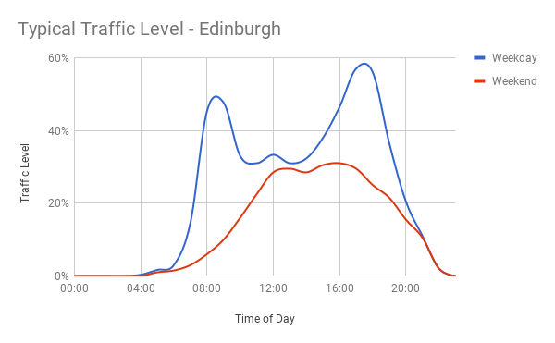
DRIVER PROFILES INITIAL FINDINGS
[TomTom, 2018]
Notes:
8 hour

Slide 11
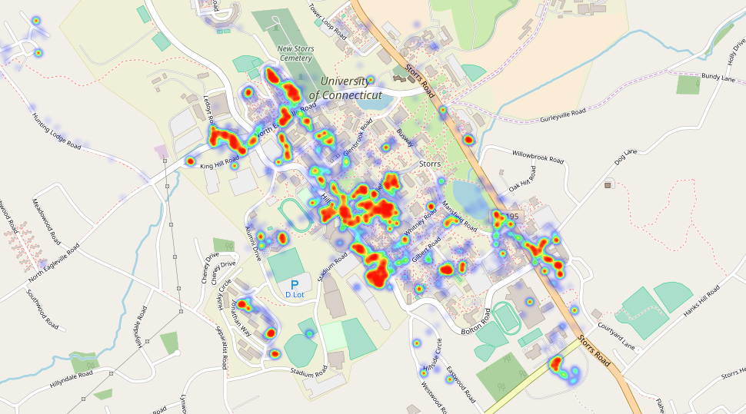
DRIVER PROFILES USER 1

Slide 12
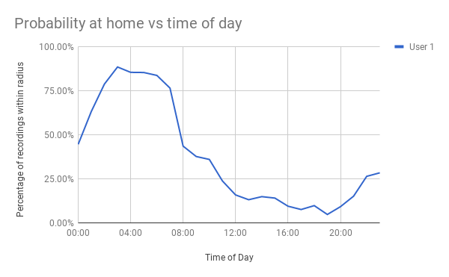
DRIVER PROFILES USER 1
Male
22 years old
Private Vehicle

Slide 13
PROJECT TIMELINE SEMESTER 2
Festival of Creative Learning
Exam week 1
Exam week 2
Week 5
Week 6
Week 8
Week 10
Week 11
Presentation 1
Presentation 2
viva-voce
examinations
Data Collection
Data Processing
Thesis Deadline
Parallel Technologies for pitfalls
Economic Model
Report Writing

Slide 15
PROJECT SCOPE OBJECTIVES
Literature Review into current and future demand response options
Frequency response
Voltage response
Technical feasibility of using delayed charging of a BEV/PHEV fleet for aggregated demand response
Load increasing/reducing
Global demand response (frequency)
Localised demand response (voltage)
Economical feasibility of using delayed charging of a BEV/PHEV fleet for aggregated demand response
Statistical risk of compliance
Cost of having diesel generator backup
Technology feasibility and implementation strategy
Sample algorithm and machine learning model

